Slide 1
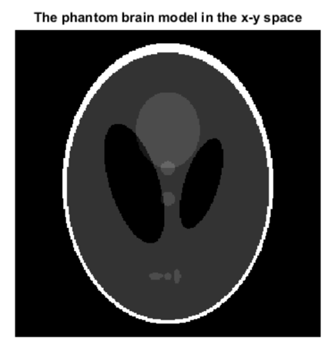
IMAGE RECONSTRUCTION USING MATLAB

Slide 2
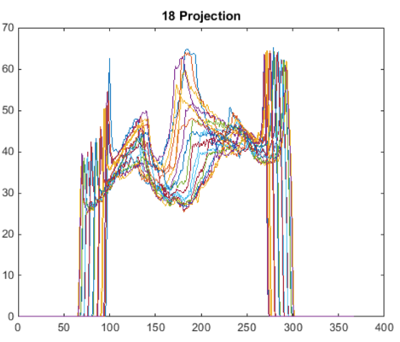
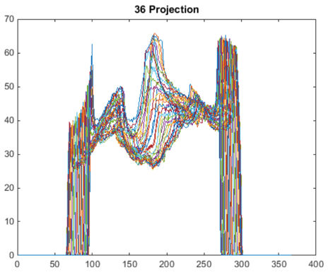
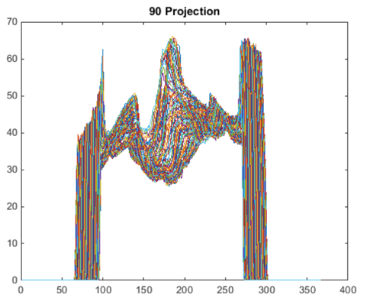
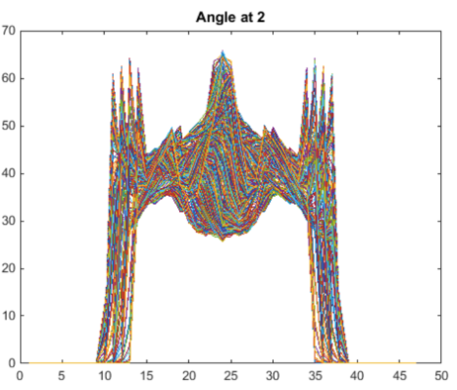
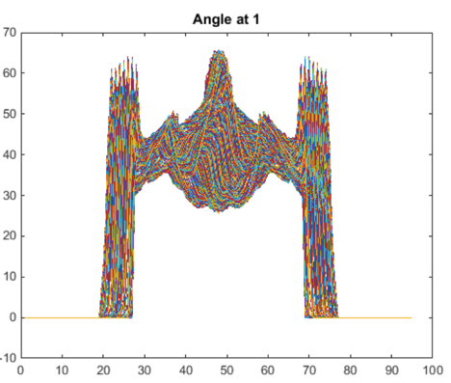
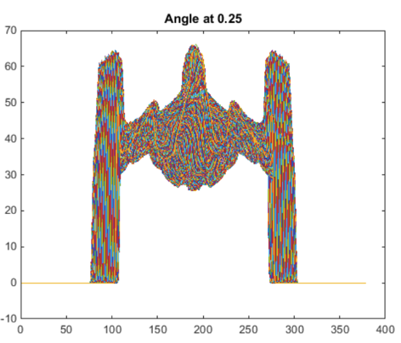
PROJECTIONS USING PARALLEL AND FAN BEAM GEOMETRY
‘Radon’
p(r,𝜃)
‘Fanbeam’
(‘Radon’ + ‘Para2fan’)
g(𝛾, β)
𝜃 = β + 𝛾
r = D sin 𝛾
Notes:
Projection can be taken from 0 to pi for parallel beam; but 0 to 360 + 2* fan angle for fan bean (full scan) 0 to 180 + 2*fan angle (short scan)

Slide 3
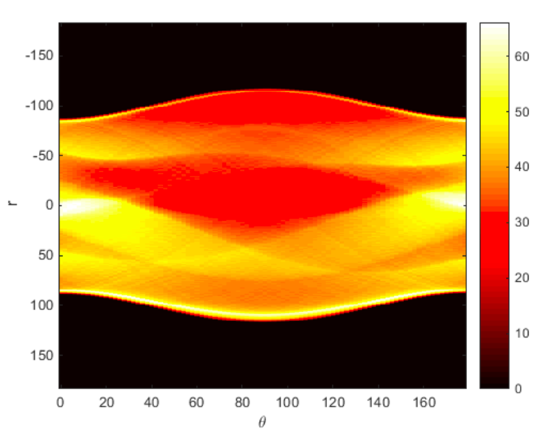
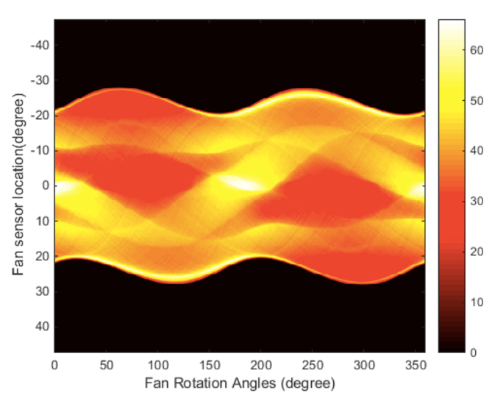
SINOGRAM OF PARALLEL AND FAN BEAM CT
r=R cos (𝜃 - ϕ)
D sin 𝛾 =R cos (β + 𝛾 - ϕ)

Slide 4
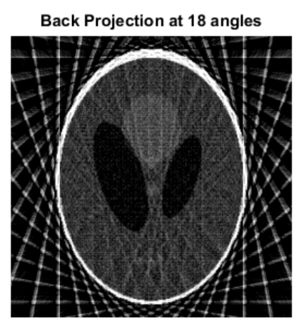
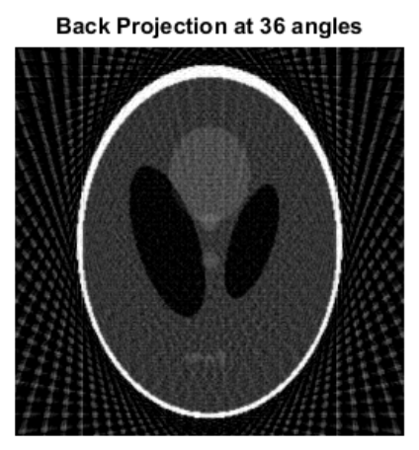
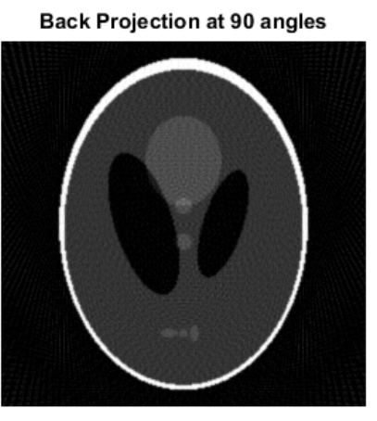
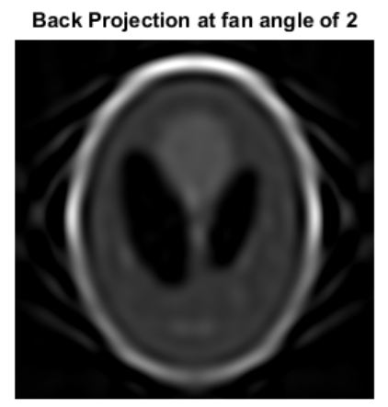
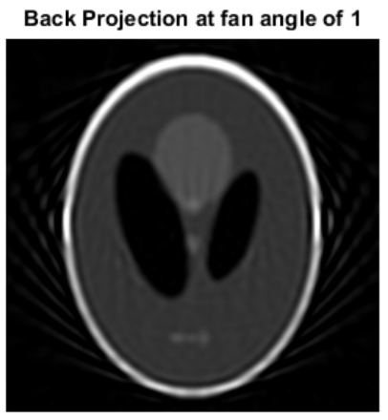
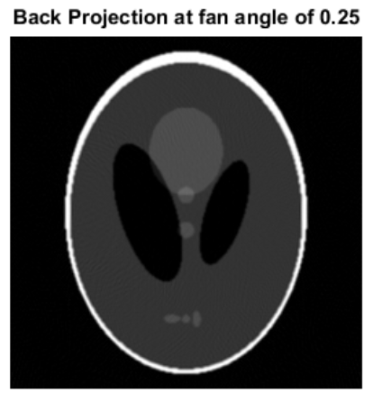
BACPROJECTION USING PARALLEL AND FAN BEAM ct
‘iRadon’
∫p(r,𝜃)d𝜃
‘iFanbeam’
(‘iRadon’ + ‘Fan2para’)
β + 𝛾 = 𝜃
D sin 𝛾 = r

